Slide 1
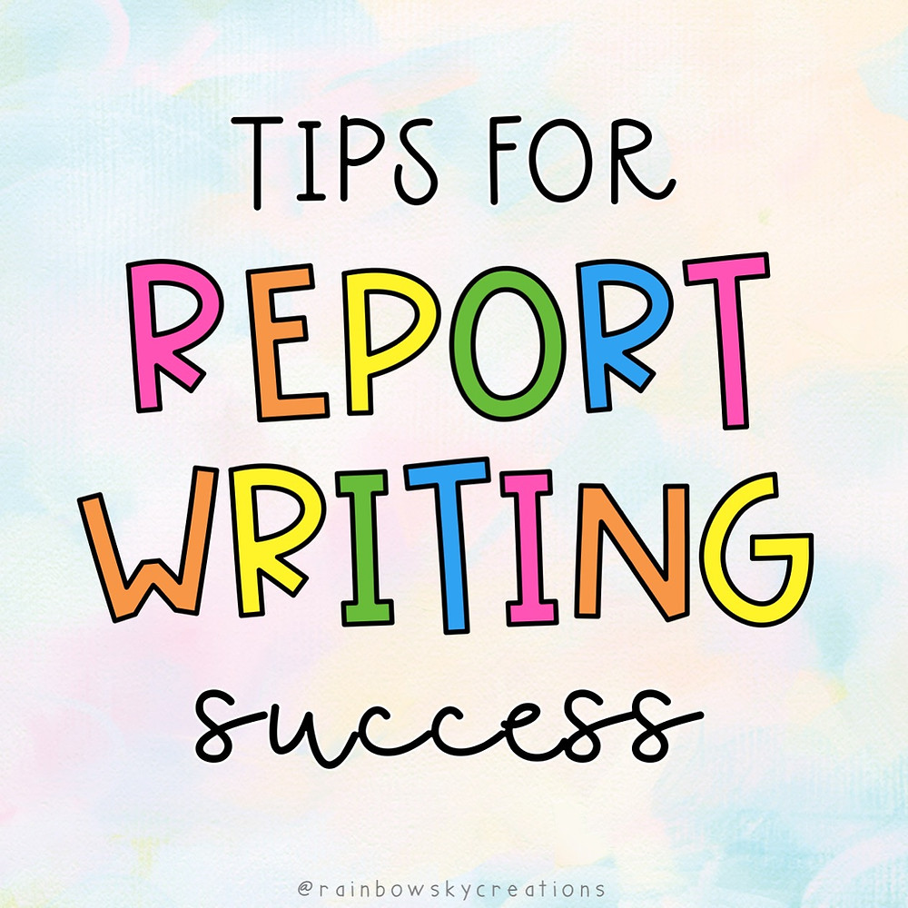
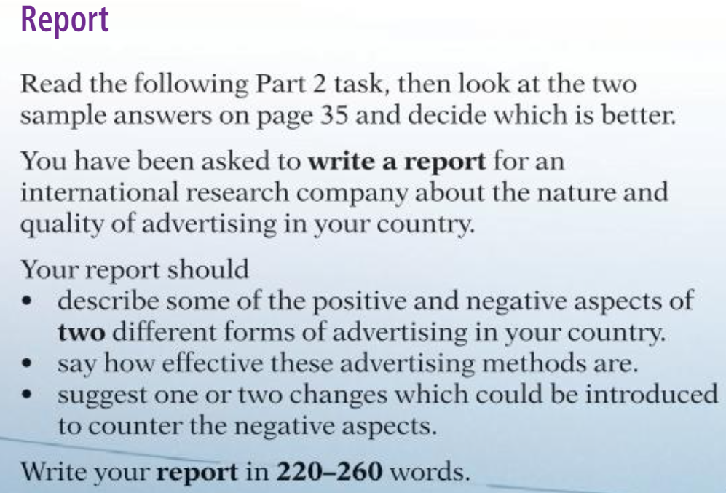
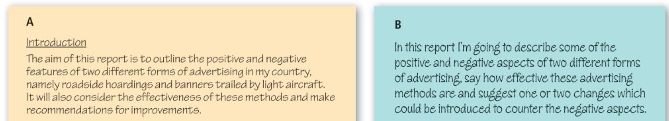

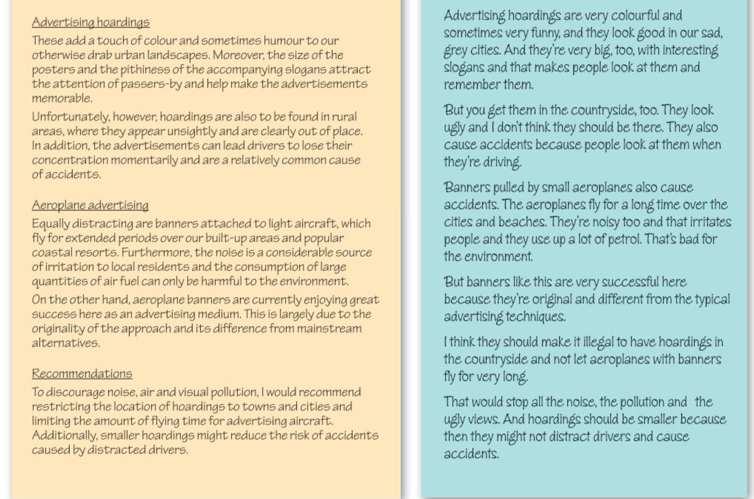
A is better as B has almost copied word for word from the question, now let’s look at the rest to compare.

Slide 2
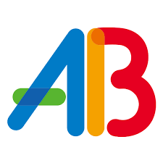
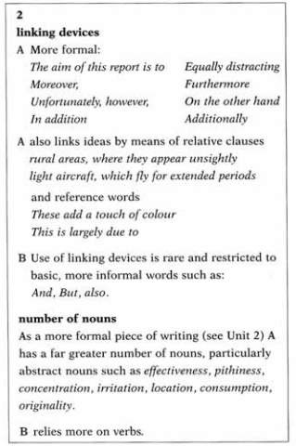
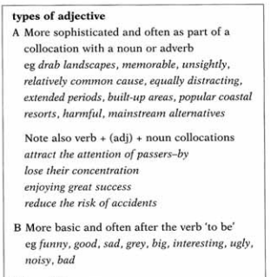
Linking devices:
Nouns:
As a formal piece of writing A has a far greater number of nouns such as
Effectiveness, pithiness, concentration, irritation, location, consumption, originality etc
REMEMBER :- more nouns more Formal
B mainly relies on verbs
Adjectives:
Other Differences:
A has given each section a heading, B has not.
B is inappropriately informal throughout and contains many contractions
Eg, I’m going to describe, and they’re very big too.
B relies heavily on repetition, showing poorer vocabulary

Slide 3

